Slide 1
Intro to Text Analysis
Catherine DeRose, PhD | HILT 2019
CC-BY

Slide 2
Overview
What is text analysis?
When and why might it be useful?
How can we get started?
Exploration with Voyant

Slide 3
What is text analysis?
Associated terms you might hear:
Distant reading (Franco Moretti)
Macroanalysis (Matthew Jockers)
Algorithmic criticism (Stephen Ramsay)
Computational literary studies (Nan Da)
Text mining, literary computing, computational text analysis

Slide 4
Early history of text analysis
Mid-twentieth century — Corpus linguistics
1930s through 1970s — Humanities computing projects
Roberto Busa and the Index Thomisticus
Female punch card operators (Terras)
Josephine Miles and the Concordance to the Poetical Works of John Dryden (Sagner Buurma and Heffernan)
1840s — Ada Lovelace, first computer programmer
1830s — Charles Babbage, inventor of the Analytical Engine

Slide 5
“Must we not pity the historians of the future if they should at any time be so conscientious as to turn over the mountains of waste paper which are now being shot by cartloads into the Museum? Human eyes and human hands cannot possibly work through a century of such agglomeration. The human mind will despair, perhaps, of power to deal with the illimitable mass. May we hope that when things come to such a crisis, human labor of the literary sort may be in part superseded by machinery? Machinery has done wonders, and when we think of what literature is becoming, it is certainly to be wished that we could read it by machinery, and by machinery digest it” (5)
- Daily News, 1869
Andrew Stauffer, "Evidence and Interpretation in the Digital Age"

Slide 6
What does our data look like?

Slide 7
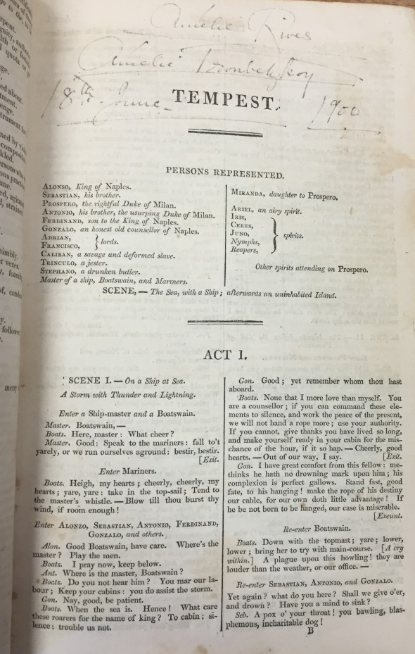
Take 2 minutes and note the things
you would count as data.
Image source: The Plays of William Shakespeare, 1823, Book Traces @ UVA
Notes:
To see the image in more detail: http://www.booktraces.org/wp-content/uploads/2016/03/IMG_1780-768x1024.jpg

Slide 8
Take 2 minutes and note the things
you would count as data.
Stage direction
Setting
Act, Scene
Marginalia
Play’s title
Characters’:
lines
affiliation
gender
relationships
Image source: The Plays of William Shakespeare, 1823, Book Traces @ UVA

Slide 9
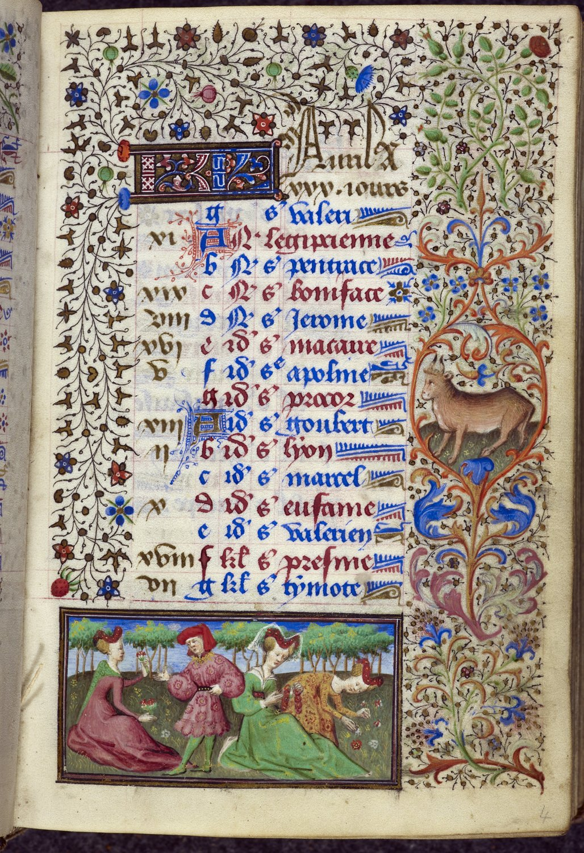
What about now?
Image source: The Book of Hours, Yates Thompson MS 3, British Library
Notes:
To see the image in more detail: https://www.bl.uk/catalogues/illuminatedmanuscripts/ILLUMIN.ASP?Size=mid&IllID=34688

Slide 10
How a computer reads
Excels at:
Counting
Words, including co-occurrence
Punctuation
Sentence or document length
Identifying spatial, temporal, and organizational words it’s been trained to recognize
Struggles with:
Ambiguity
Irony
Sarcasm
Explanation

Slide 11
Optical Character Recognition (OCR)
Process of turning an image of text into searchable, machine-actionable text
Level of success depends (font, image quality)
Works best on typescript materials
Transkribus aims to OCR handwritten materials
Notes:
Transkribus: https://transkribus.eu/Transkribus/

Slide 12
Optical Character Recognition (OCR), continued
Important to consider how your texts were (or will be) digitized and OCRed
Example from Chronicling America database:
‘Q i-jtb the Raven’ (Cordell)

Slide 13
Stop words -> stoplist
Words you want the computer to omit
Function words (prepositions, conjunctions, etc.)
Other extremely frequent words
Noisy words
“Sometimes, some extremely common words which would appear to be of little value in helping select documents matching a user need are excluded from the vocabulary entirely. These words are called stop words.” - Stanford NLP
Example from Brandon Locke and Thomas Padilla
Notes:
Link to quote: https://nlp.stanford.edu/IR-book/html/htmledition/dropping-common-terms-stop-words-1.html

Slide 14
Stop words -> stoplist, continued
It is standard practice to create (or adapt) a stoplist for many text analysis projects, but not for all
For instance, function words are important for stylometric analysis

Slide 15
What does text analysis look like in practice?

Slide 16
N-gram analysis
Often working with unigrams, bigrams, or trigrams (one word, two word, three word pairs)
Useful for tracking a word’s frequency over time in a single text or across thousands of texts

Slide 17
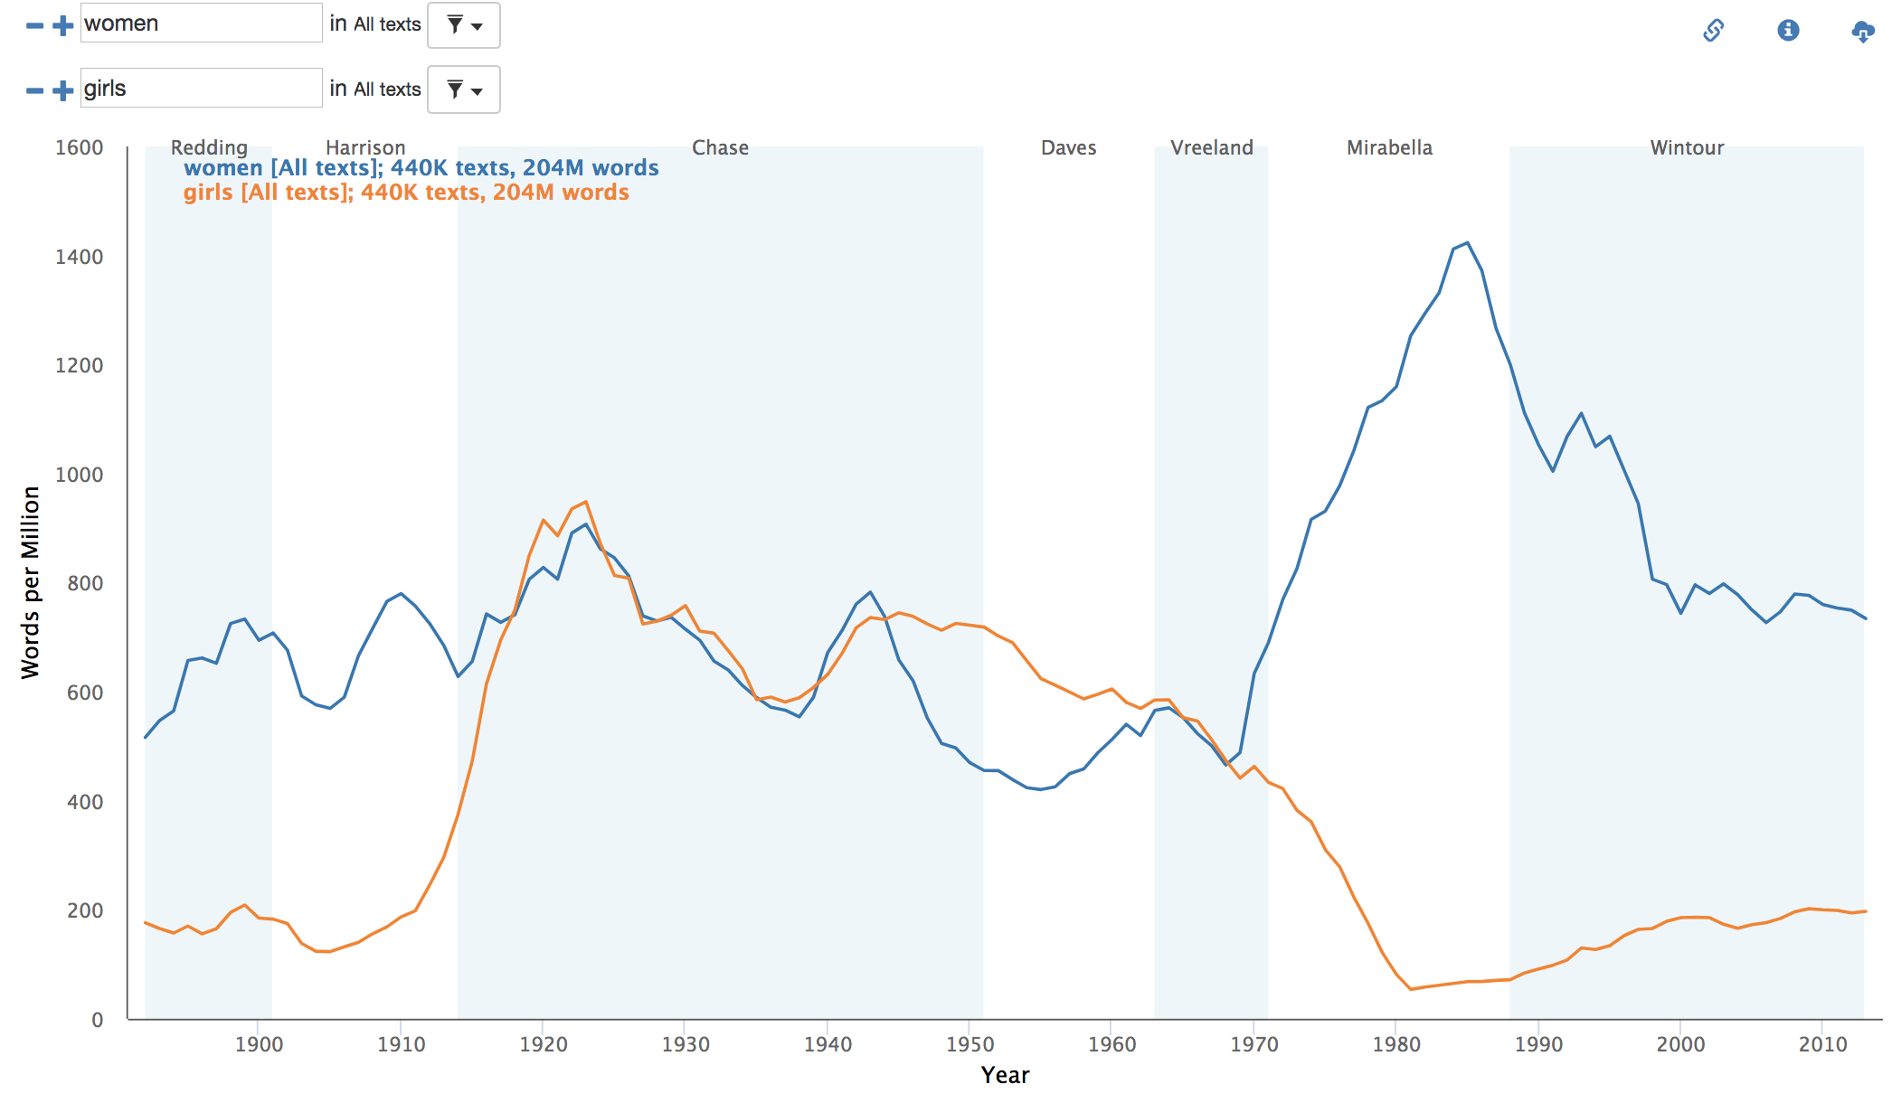
Robots Reading Vogue
http://dh.library.yale.edu/projects/vogue/
Notes:
Ben Schmidt’s Bookworm https://github.com/Bookworm-project/BookwormDB

Slide 18
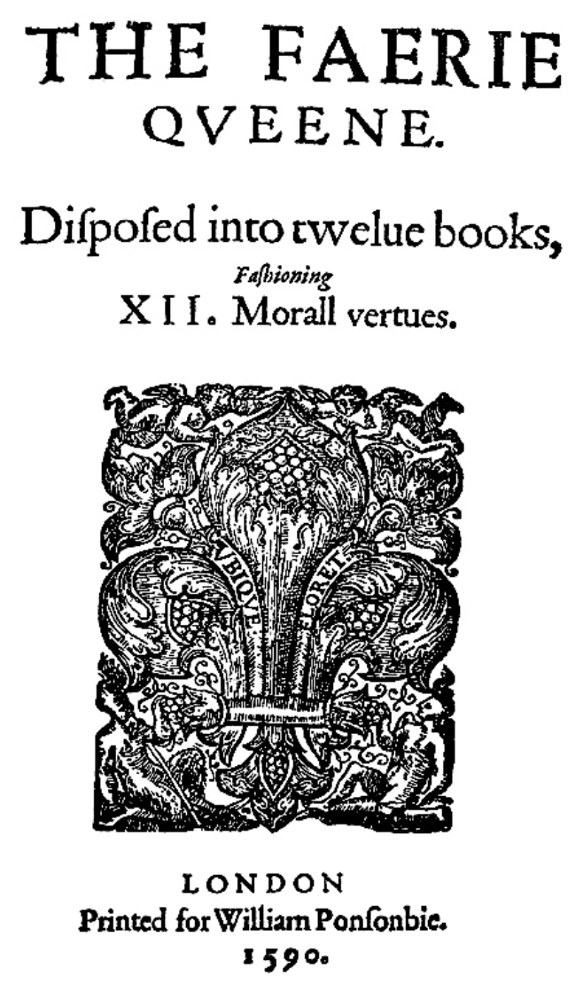
Limitations/cautions
Dependent on OCR quality
What error might you anticipate with the title page to the right?
Notes:
Image from: https://en.wikipedia.org/wiki/The_Faerie_Queene#/media/File:The_Faerie_Queene_frontispiece.jpg

Slide 19
Limitations/cautions, continued
Same word can mean different things
You have to know what words might be meaningful

Slide 20
Concordance plots
Highlight where a word or phrase occurs, along with what words precede or follow it
Useful for finding linguistic patterns in a single text or at larger scales

Slide 21
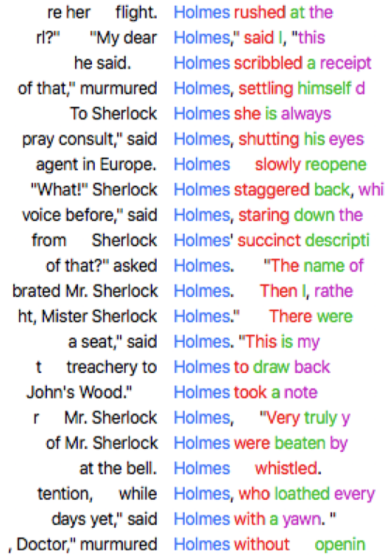
How is Sherlock Holmes featured linguistically in A Scandal in Bohemia?

Slide 22
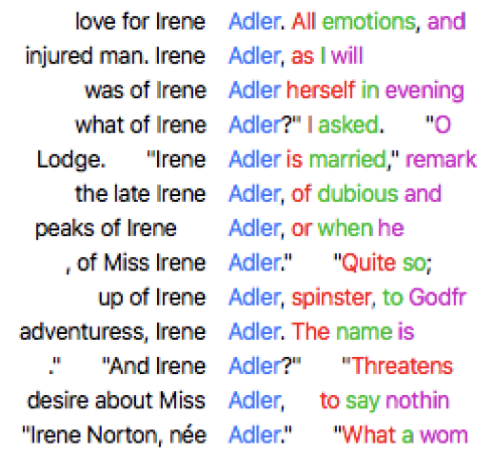
How about Irene Adler?

Slide 23
Example from Annie Swafford and her students in “Virtually London: Literature and Laptops” class

Slide 24
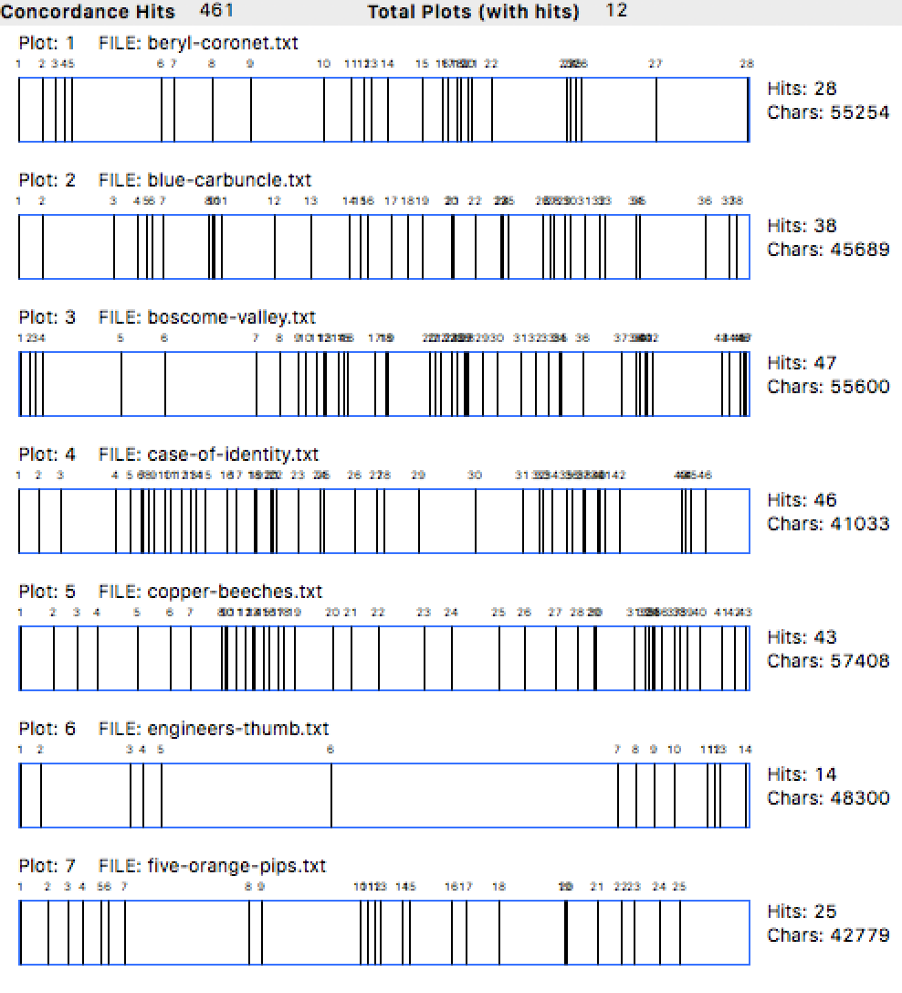
Each rectangle represents one short story from beginning to end
A vertical line indicates the appearance of the word ‘Holmes’ at that point in the story
Do any texts stand out for one reason or another?

Slide 25

AntConc
WHAT: Concordance software created and maintained by Laurence Anthony
WHY: To find linguistic patterns in a corpus
HOW: Runs locally, requires plain text files with .txt extension
DOCUMENTATION: http://www.laurenceanthony.net/software/antconc/releases/AntConc357/help.pdf
TUTORIAL: https://programminghistorian.org/en/lessons/corpus-analysis-with-antconc

Slide 26
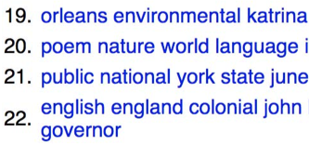
Topic modeling
Technique for identifying topics or discourses in a large collection of texts that looks at word co-occurrences
Useful for when you don’t know what words to search for or when the scale exceeds what you can close read — results can point to patterns, exemplars, or outliers to look at more closely

Slide 27
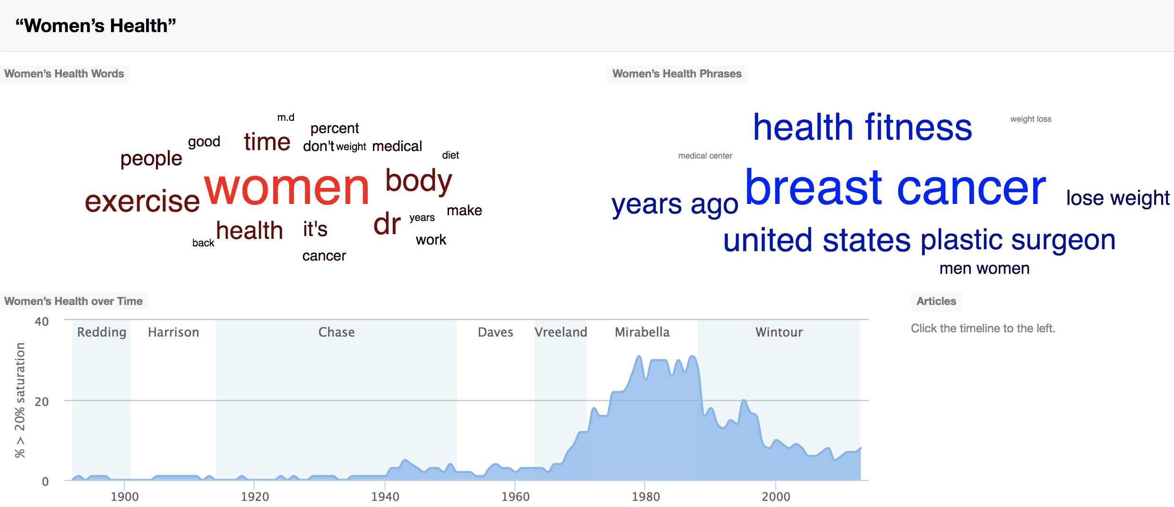
Robots Reading Vogue
http://dh.library.yale.edu/projects/vogue/topics/

Slide 28
Stylometry
The study of literary style via quantitative methods
Useful for identifying the likely authors of disputed texts (authorship attribution) or for looking at changes in style across a single or multiple authors or genres

Slide 29
The Federalist Papers
85 papers political papers published in 1787-1788 that advocated the ratification of the U.S. Constitution
Published under the pseudonym ‘Publius,’ but we know they were written by Alexander Hamilton, James Madison, and John Jay
The question remains: who wrote which papers?

Slide 30
The Federalist Papers, continued
Challenges presented by the papers:
published under a pseudonym
published within a short time span of one another
covered a similar topic
shared cultural and political references
Frederick Mosteller and David Lee Wallace (1964)
Tutorial: https://programminghistorian.org/en/lessons/introduction-to-stylometry-with-python

Slide 31
Sentiment analysis
Attempt to quantify the positivity, neutrality, or negativity of a text
Useful for identifying large shifts in sentiment across multiple texts over time
Example use cases: reviews, Tweets, newspapers, novels

Slide 32
Limitations/cautions
Computers struggle with recognizing irony, sarcasm, ambiguity
Words are historically and culturally contingent

Slide 33
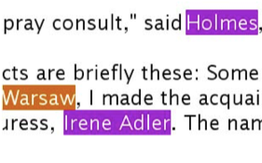
Named entity recognition (NER)
Process for extracting entities (people, places, organizations, etc.) from text, turns unstructured text into structured text
Useful for extracting specific data from your texts to analyze/visualize or use for a stopword list

Slide 34
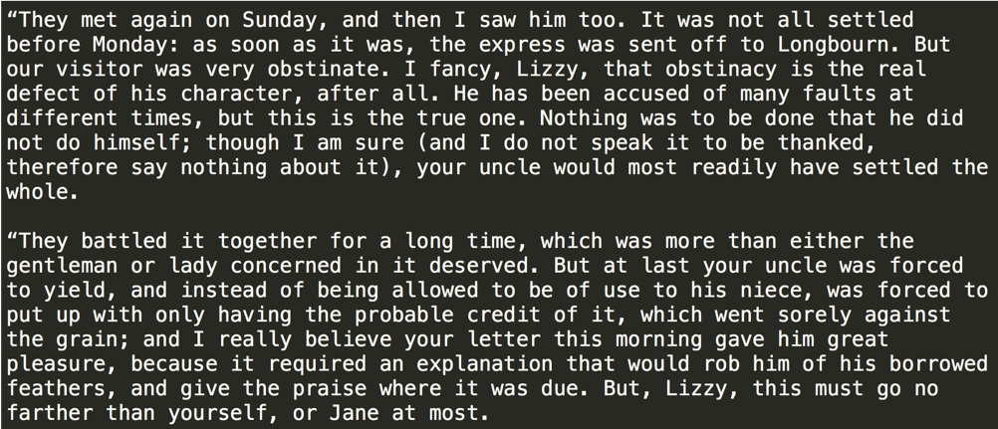
Unstructured plain text

Slide 35
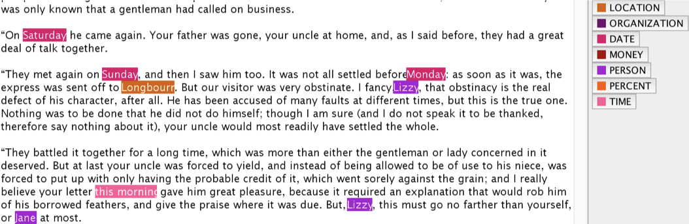
Visual representation of how NER works with Stanford’s NER graphical user interface (GUI)

Slide 36
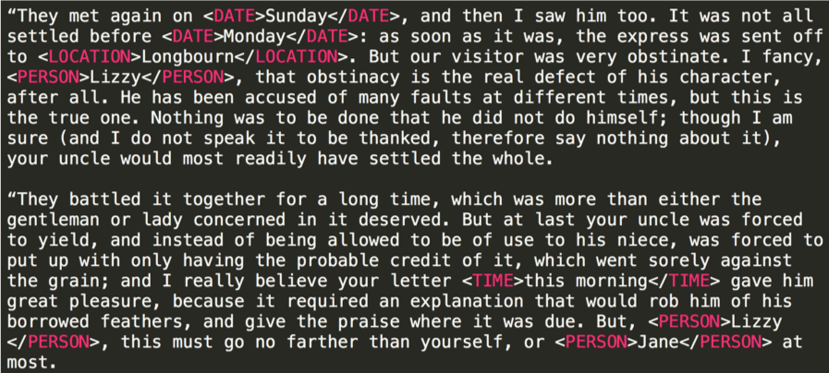
Structured NER output

Slide 37
Limitations/cautions
There will be errors that occur in the form of
omission (a word doesn’t get tagged that a human reader would tag)
miscategorization (a word receives an incorrect tag)

Slide 38
What to do if your texts can’t be OCRed?

Slide 39
Crowdsourced transcription
Humans type the text they see in the image
Useful for building machine-actionable corpora and for communicating research to broader publics

Slide 40
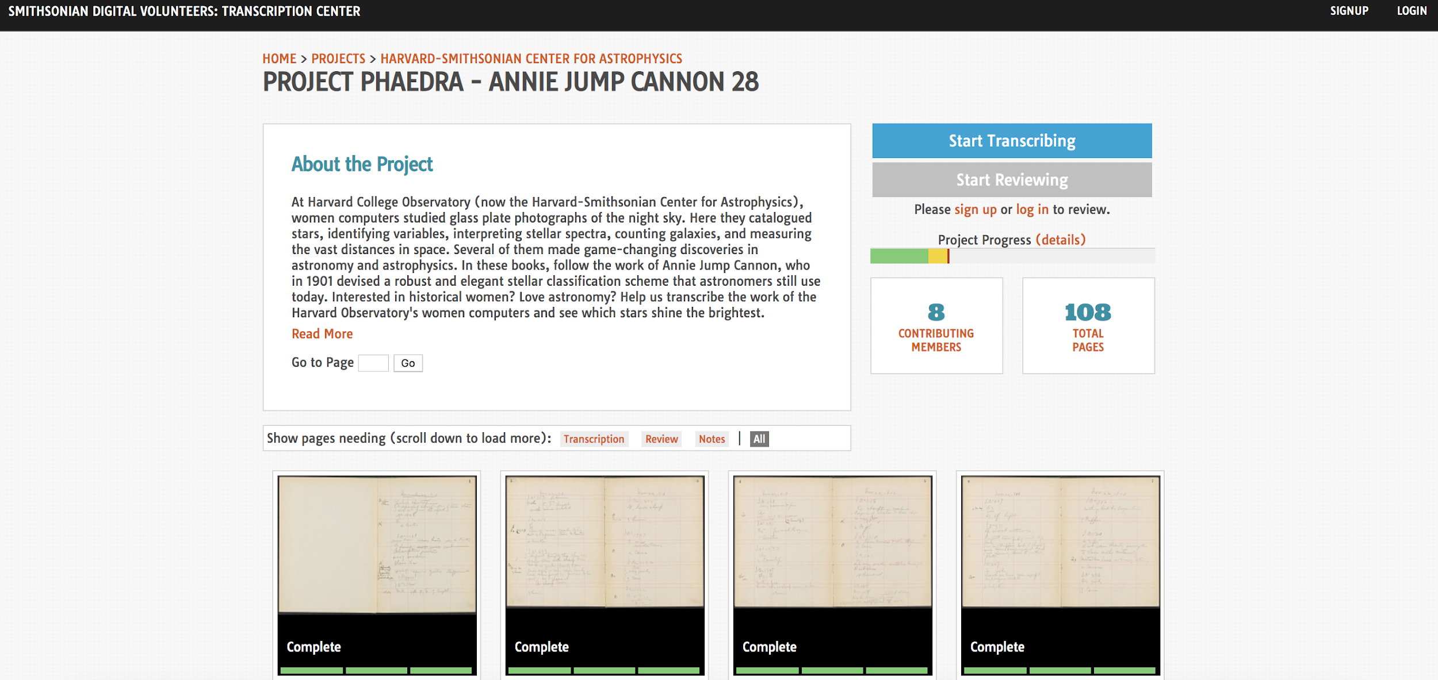
Project Phaedra
https://transcription.si.edu/project/10414

Slide 41
Limitations/cautions
Progress and quality of the transcriptions are dependent on contributors’ interest
Ethical considerations, both for the contributors and over the source material

Slide 42
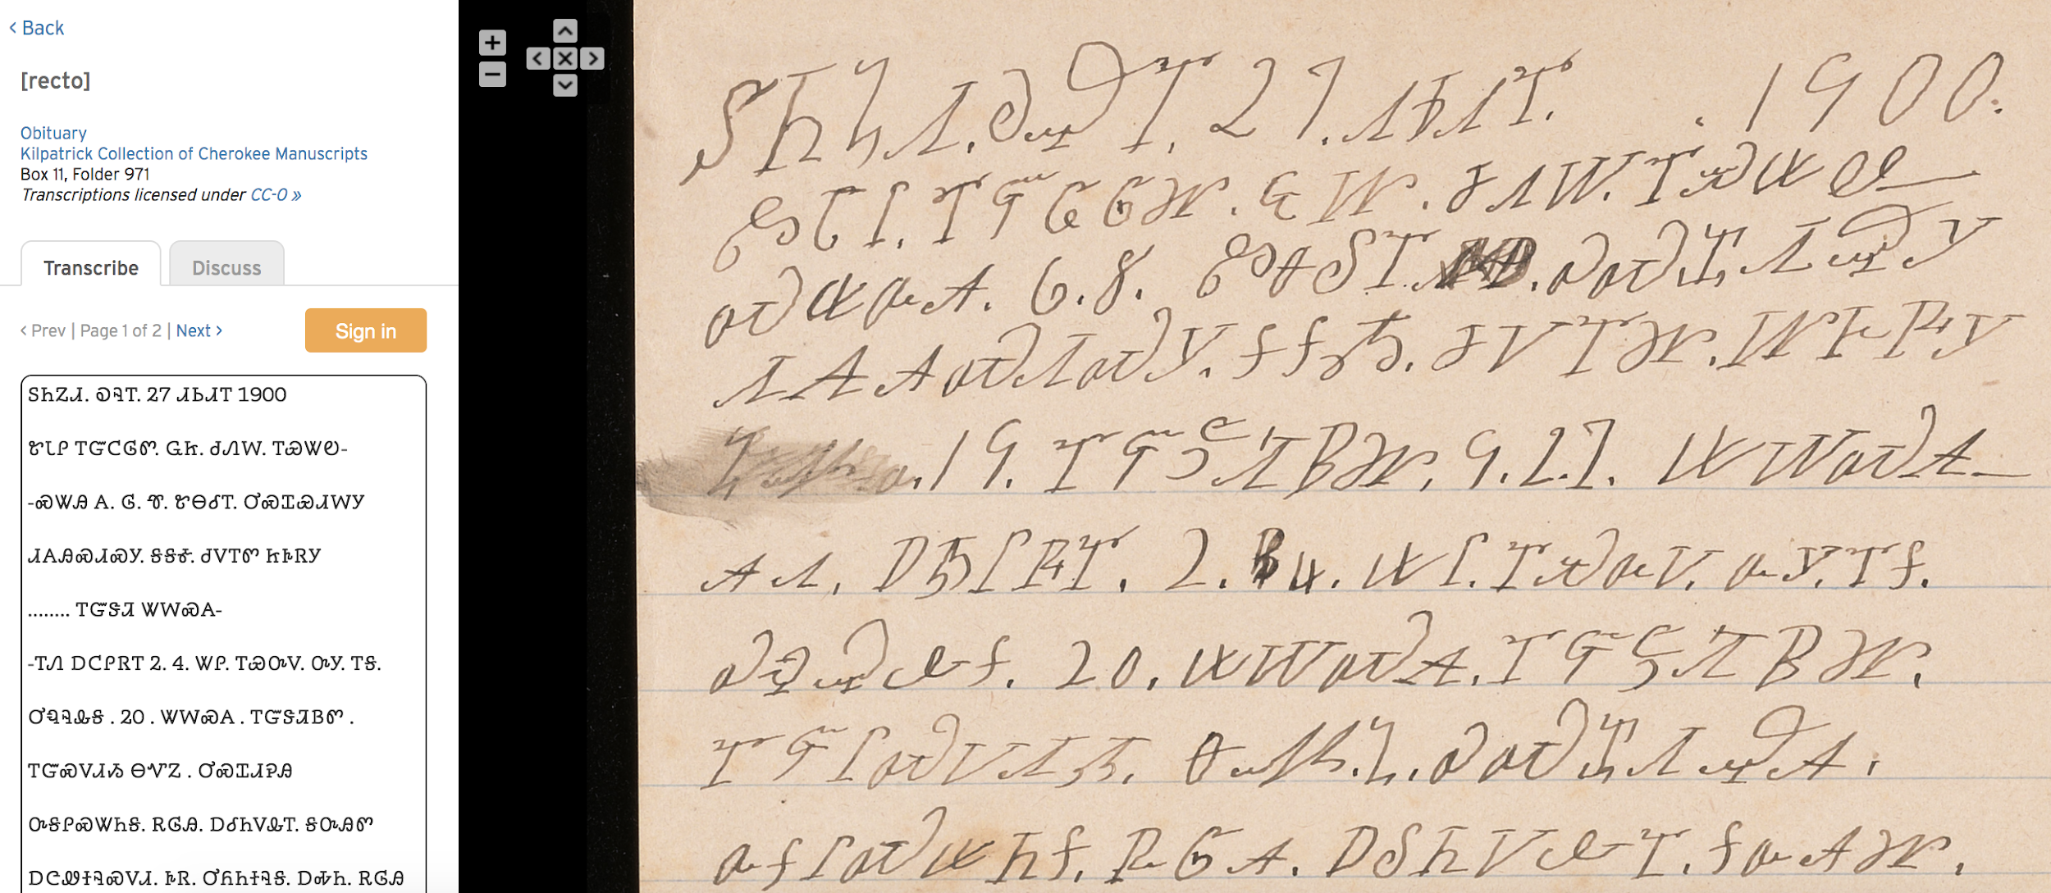
Transcribe@Yale
http://transcribe.library.yale.edu/projects/

